Slide 1
Lecture 11 Introduction to probability

Slide 2
Review

Slide 3
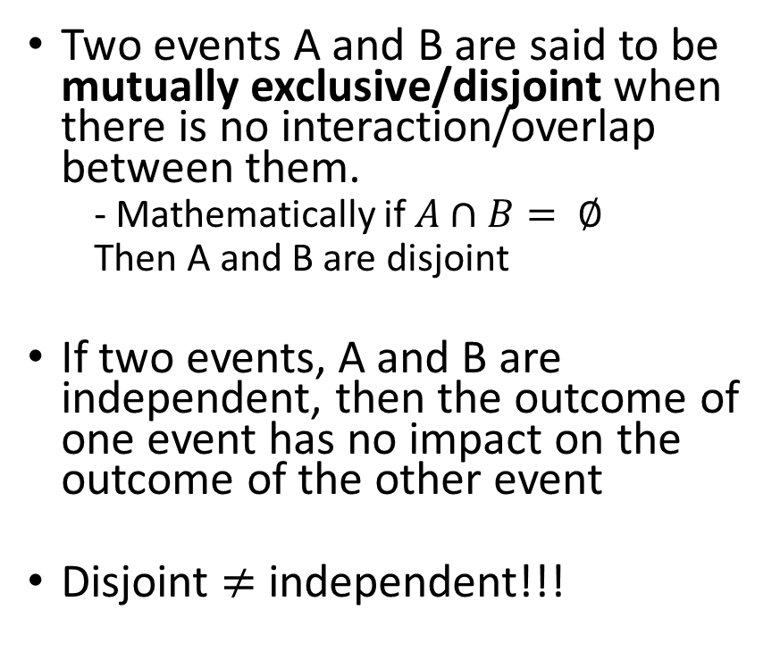
Disjoint vs independent
Two events A and B are said to be mutually exclusive/disjoint when there is no interaction/overlap between them.
- Mathematically if $A∩B= ∅$
Then A and B are disjoint
If two events, A and B are independent, then the outcome of one event has no impact on the outcome of the other event
Disjoint $≠$ independent!!!
The Sample Space
Event A
Event B

Slide 4
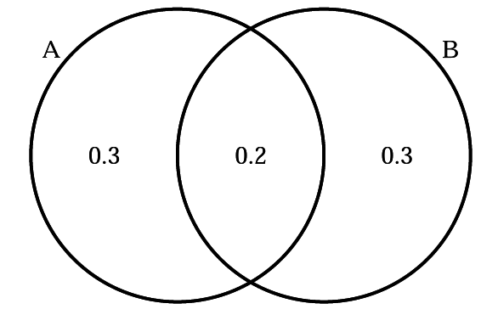
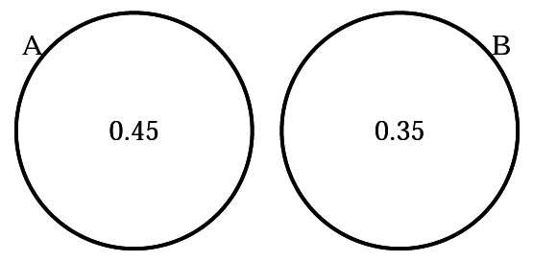
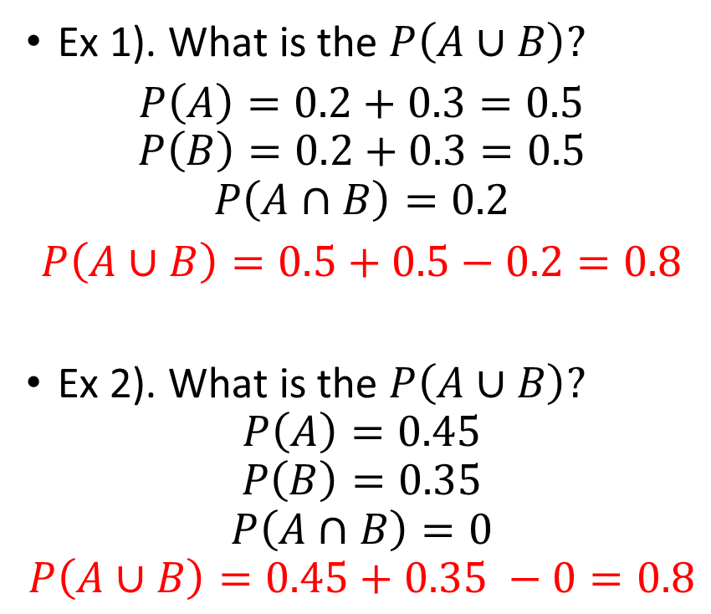
Practice:
Ex. 1
Ex 1). What is the $P\left(A∪B\right)?$
$P\left(A\right)=0.2+0.3=0.5$
$$P\left(B\right)=0.2+0.3=0.5$$
$$P\left(A∩B\right)=0.2$$
$P\left(A∪B\right)=0.5+0.5−0.2=0.8$
Ex 2). What is the $P\left(A∪B\right)?$
$$P\left(A\right)=0.45$$
$$P\left(B\right)=0.35$$
$$P\left(A∩B\right)=0$$
$$P\left(A∪B\right)=0.45+0.35 −0=0.8$$
Ex. 2

Slide 5
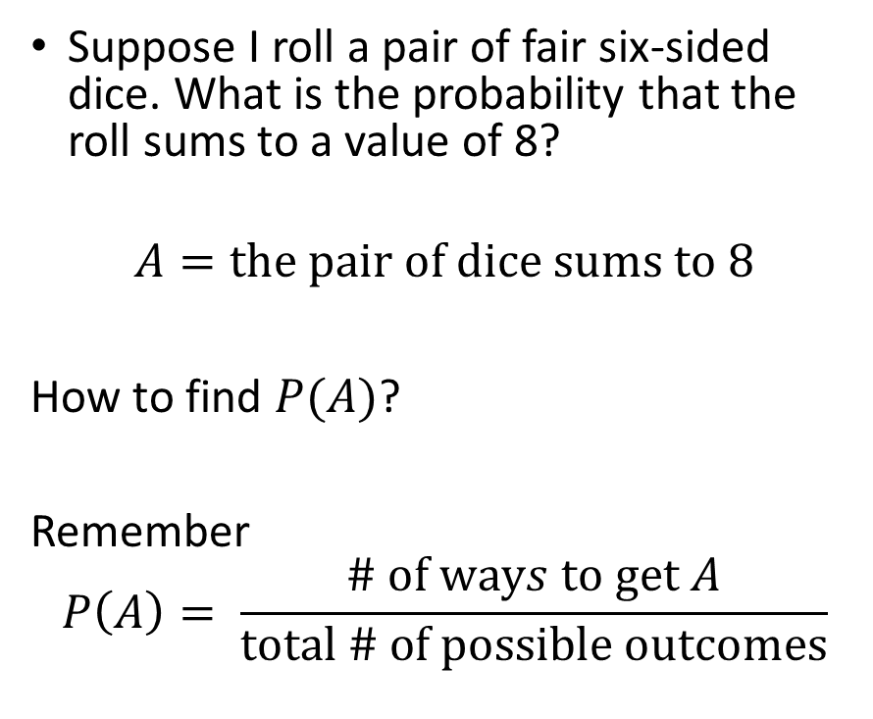
Practice
Suppose I roll a pair of fair six-sided dice. What is the probability that the roll sums to a value of 8?
$$A=the pair of dice sums to 8$$
How to find $P(A)$?
Remember
$$P\left(A\right)= \frac{\# of ways to get A}{total \# of possible outcomes}$$

Slide 6
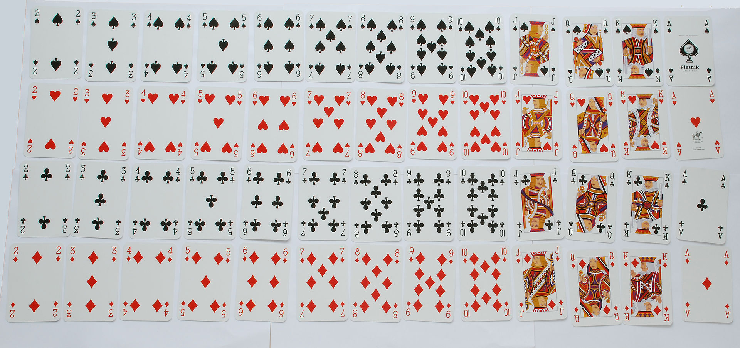

Practice
Suppose a select a card at random from a well-shuffled deck of cards. What is the probability that the card is a king or hearts?
$$A=card is a king$$
$$B=the suit is hearts$$
Question: What is $P\left(A∪B\right)$

Slide 7
Random Variables and Probability Distributions
Review: Randomly sampling a population represents a random trial just like rolling a die or flipping a coin.
The value of a variable measured on a randomly sampled individual is an outcome of a random trial. The following are therefore also random trials:
Measuring the heights of a randomly selected college students​
Randomly sampling the diameter of trees on a plot of land​
A Random Variable occurs when we assign values to the outcomes of random processes. Formally, it is a function that maps from the sample space of event to a value.
- discrete random variables have a countable number of values
-continuous random variables have an uncountable number of values

Slide 8
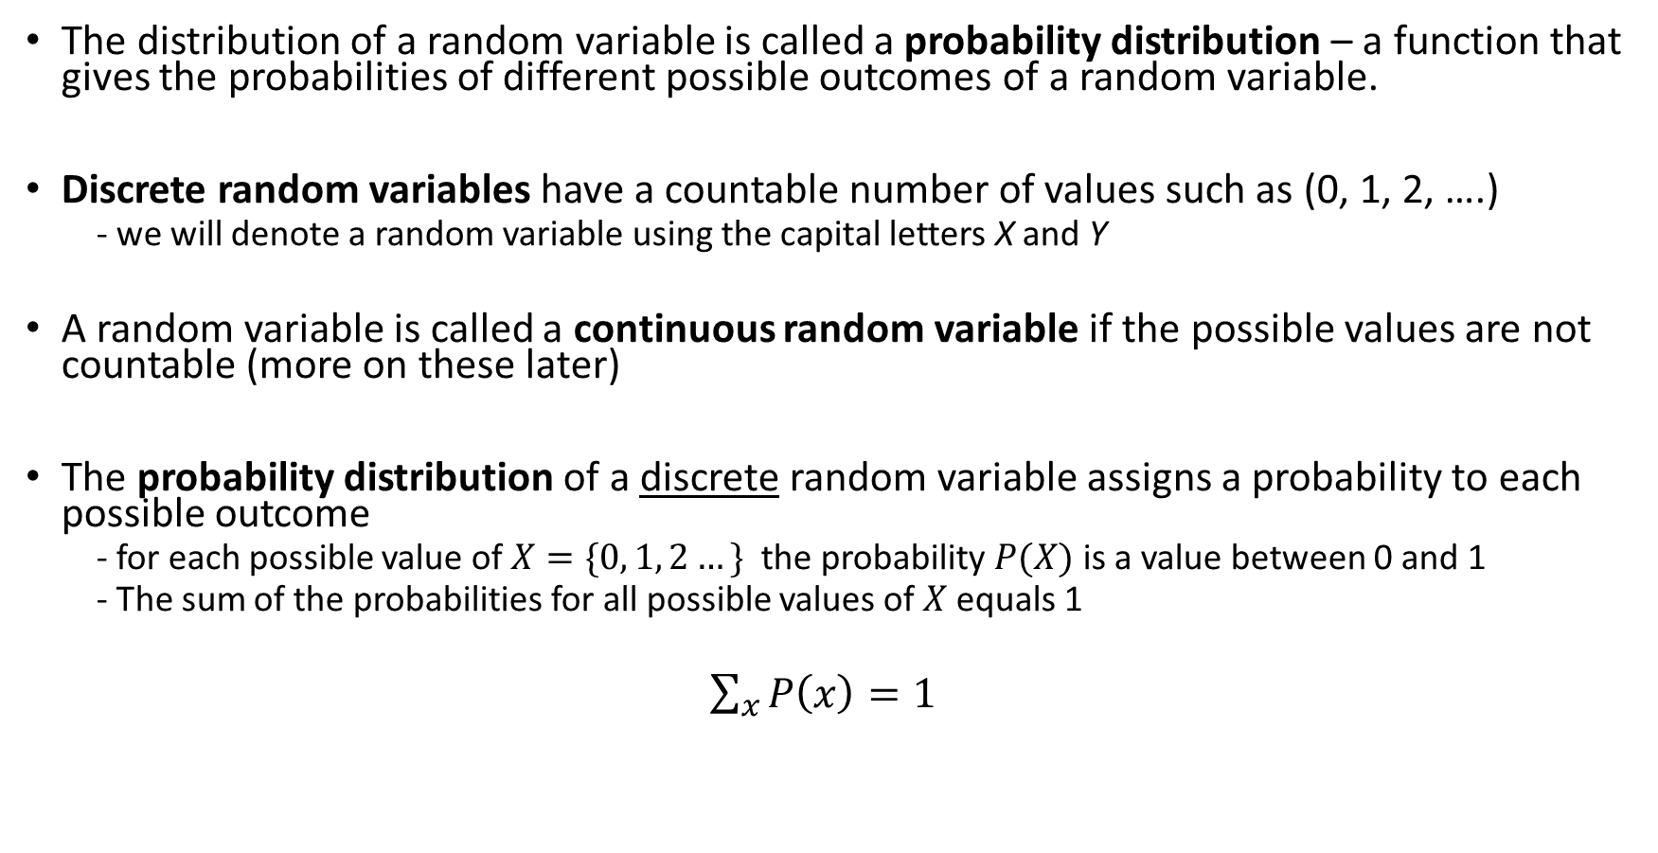
Probability Distributions
The distribution of a random variable is called a probability distribution – a function that gives the probabilities of different possible outcomes of a random variable.
Discrete random variables have a countable number of values such as (0, 1, 2, ….)
- we will denote a random variable using the capital letters X and Y
A random variable is called a continuous random variable if the possible values are not countable (more on these later)
The probability distribution of a discrete random variable assigns a probability to each possible outcome
- for each possible value of $X=\{0, 1, 2…\}$ the probability $P(X)$ is a value between 0 and 1
- The sum of the probabilities for all possible values of $X$ equals 1
$\sum_{x}{P\left(x\right)=1 }$

Slide 9
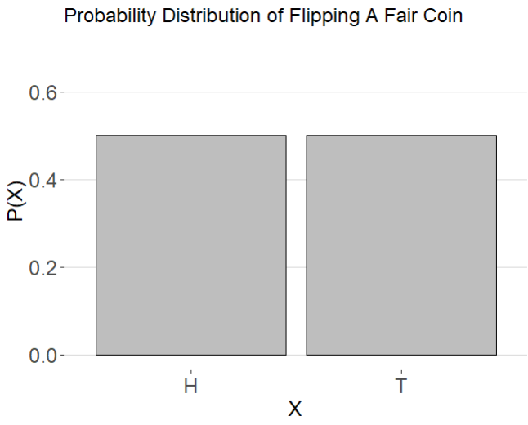
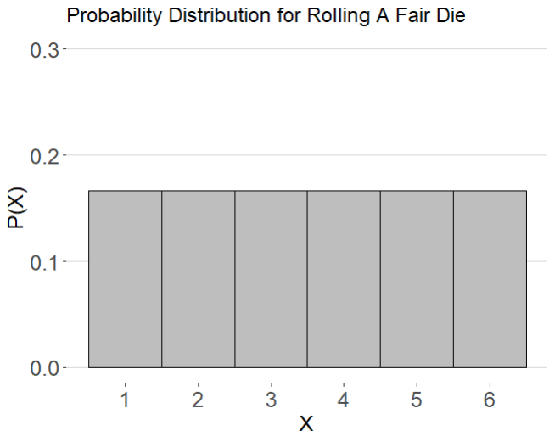
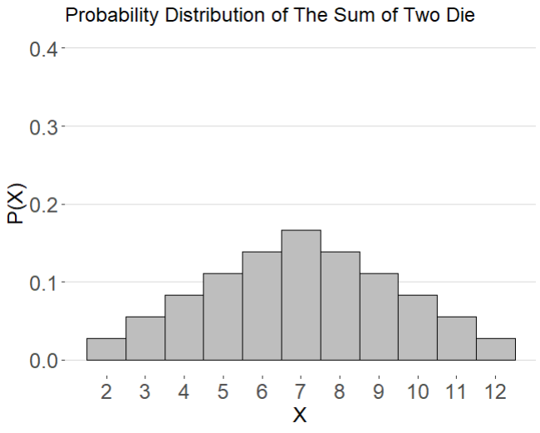
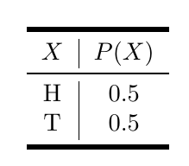
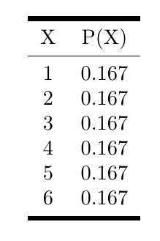
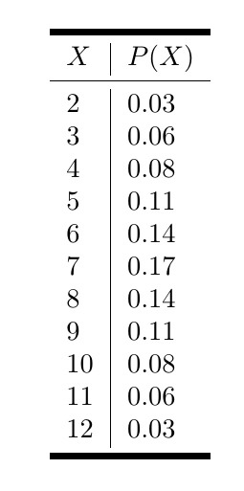

Slide 10
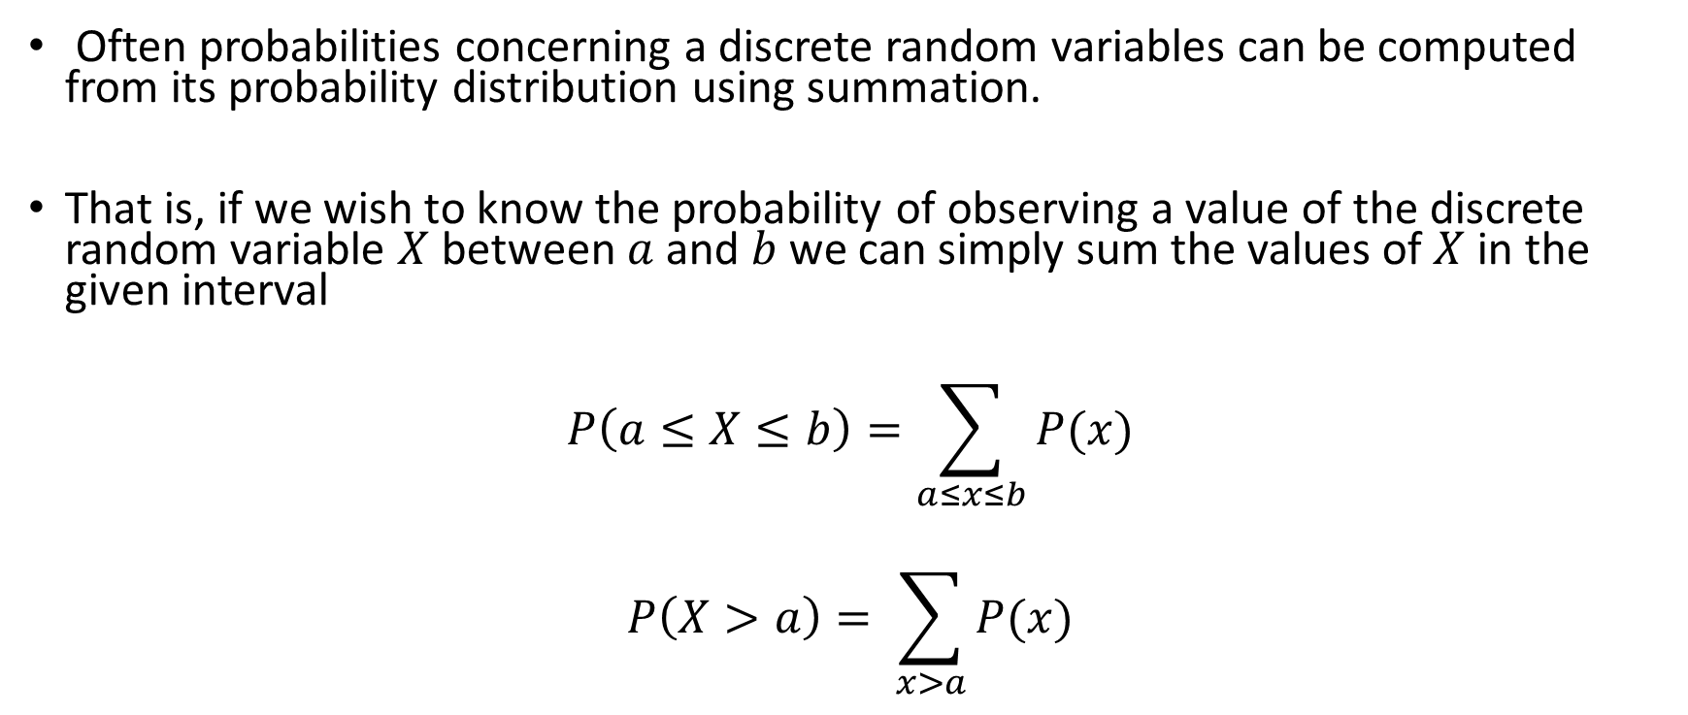
Computing Probabilities from Discrete Probability Distributions
Often probabilities concerning a discrete random variables can be computed from its probability distribution using summation.
That is, if we wish to know the probability of observing a value of the discrete random variable $X$ between $a$ and $b$ we can simply sum the values of $X$ in the given interval
$$P\left(a≤X≤b\right)=\sum_{a≤x≤b}{P(x)}$$
$$P\left(X>a\right)= \sum_{x>a}{P(x)}$$

Slide 11
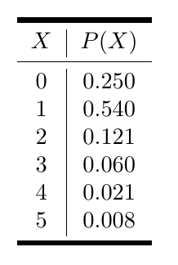
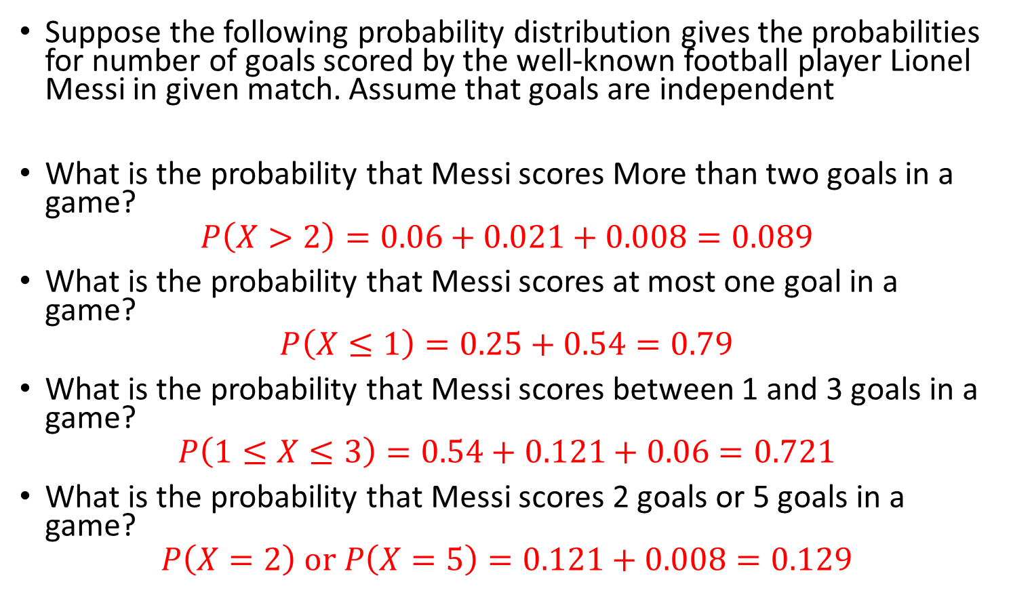
Computing Probabilities
Suppose the following probability distribution gives the probabilities for number of goals scored by the well-known football player Lionel Messi in given match. Assume that goals are independent
What is the probability that Messi scores More than two goals in a game?
$$P\left(X>2\right)=0.06+0.021+0.008=0.089$$
What is the probability that Messi scores at most one goal in a game?
$$P\left(X≤1\right)=0.25+0.54=0.79$$
What is the probability that Messi scores between 1 and 3 goals in a game?
$$P\left(1≤X≤3\right)=0.54+0.121+0.06=0.721$$
What is the probability that Messi scores 2 goals or 5 goals in a game?
$$P\left(X=2\right) or P\left(X=5\right)=0.121+0.008=0.129$$

Slide 12
Two important probability distributions in statistical inference
A Population Distribution – is the probability distribution for a single observation
A Sampling Distribution – is the probability distribution of a statistic

Slide 13
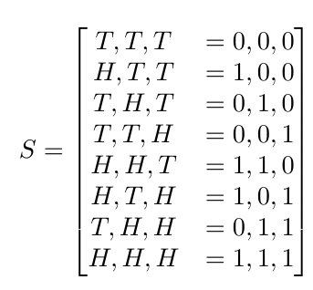
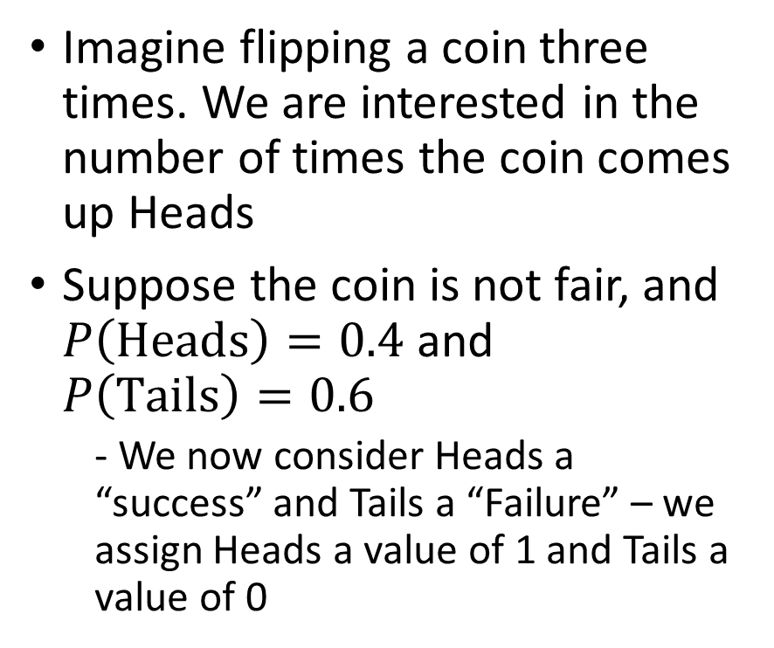
Deriving Sampling Distributions
Imagine flipping a coin three times. We are interested in the number of times the coin comes up Heads
Suppose the coin is not fair, and $P\left(Heads\right)=0.4$ and $P\left(Tails\right)=0.6$
- We now consider Heads a “success” and Tails a “Failure” – we assign Heads a value of 1 and Tails a value of 0

Slide 14
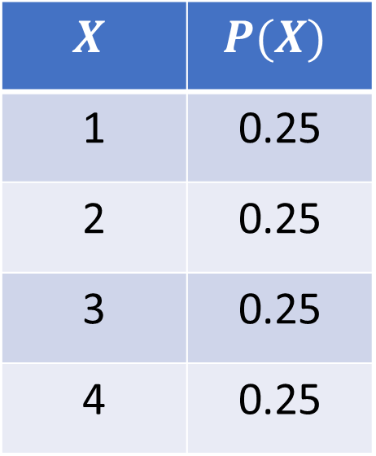
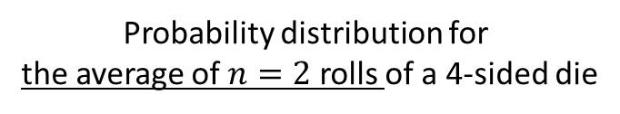
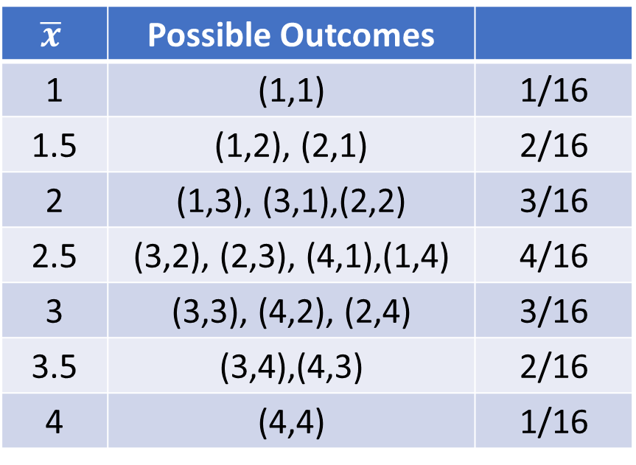
Deriving Sampling Distributions
Population Distribution
Sampling Distribution
Probability distribution for
the average of $n=2$ rolls of a 4-sided die
Probability distribution for
a single roll of a 4-sided die
$$X$$ | $$P(X)$$
1 | 0.25
2 | 0.25
3 | 0.25
4 | 0.25
$$\overline{x}$$ | Possible Outcomes
1 | (1,1) | 1/16
1.5 | (1,2), (2,1) | 2/16
2 | (1,3), (3,1),(2,2) | 3/16
2.5 | (3,2), (2,3), (4,1),(1,4) | 4/16
3 | (3,3), (4,2), (2,4) | 3/16
3.5 | (3,4),(4,3) | 2/16
4 | (4,4) | 1/16

Slide 15
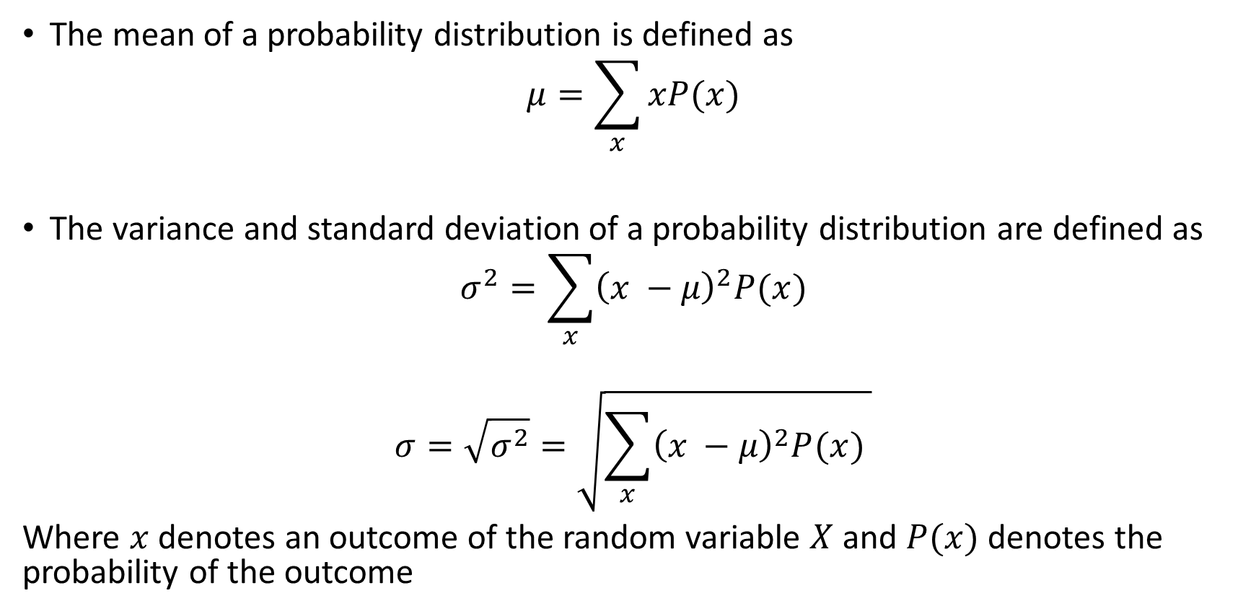
Mean and Standard Deviation of Discrete Random Variables
The mean of a probability distribution is defined as
$$μ=\sum_{x}{xP(x)}$$
The variance and standard deviation of a probability distribution are defined as
$$σ^{2}=\sum_{x}{{\left(x −μ\right)}^{2}P(x})$$
$$σ=\sqrt{σ^{2}}=\sqrt{\sum_{x}{{\left(x −μ\right)}^{2}P(x}) }$$
Where $x$ denotes an outcome of the random variable $X$ and $P(x)$ denotes the probability of the outcome

Slide 16
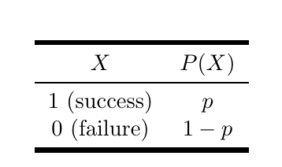
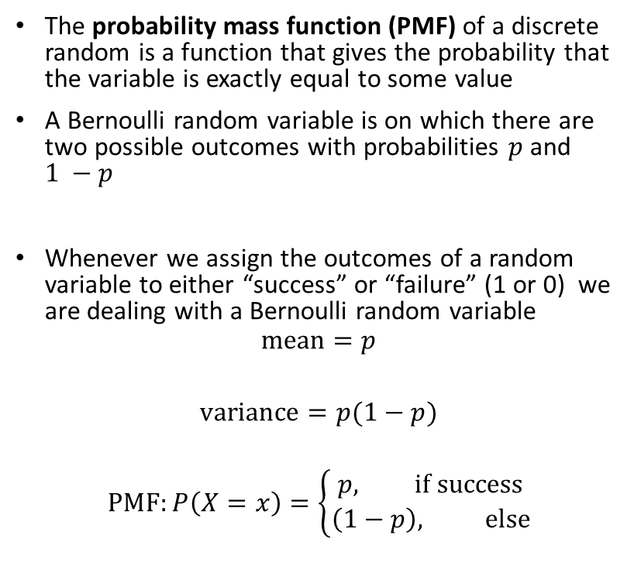
The Bernoulli distribution
The probability mass function (PMF) of a discrete random is a function that gives the probability that the variable is exactly equal to some value
A Bernoulli random variable is on which there are two possible outcomes with probabilities $p$ and $1 −p$
Whenever we assign the outcomes of a random variable to either “success” or “failure” (1 or 0) we are dealing with a Bernoulli random variable
$$mean=p$$
$$variance=p(1−p)$$
$$PMF:P\left(X=x\right)=\left\{\begin{aligned}p, if success \\ \left(1−p\right), else\end{aligned}\right.$$

Slide 17
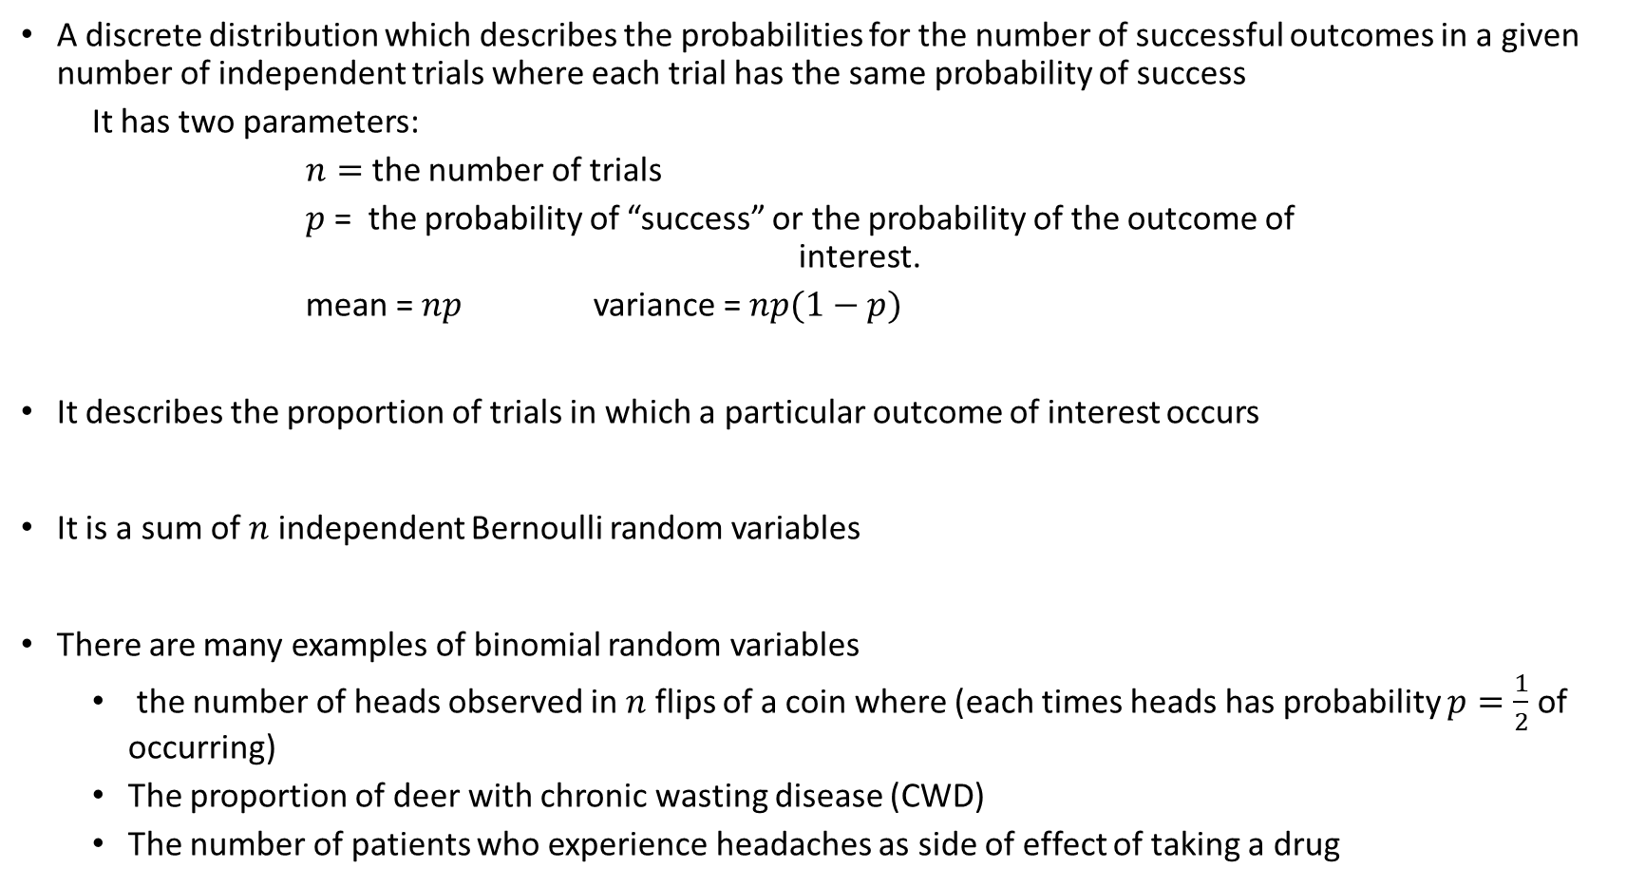
The Binomial Distribution
A discrete distribution which describes the probabilities for the number of successful outcomes in a given number of independent trials where each trial has the same probability of success
It has two parameters:
$n=$ the number of trials
$p$ = the probability of “success” or the probability of the outcome of interest.
mean = $np$ variance = $np(1−p)$
It describes the proportion of trials in which a particular outcome of interest occurs
It is a sum of $n$ independent Bernoulli random variables
There are many examples of binomial random variables
the number of heads observed in $n$ flips of a coin where (each times heads has probability $p=\frac{1}{2}$ of occurring)
The proportion of deer with chronic wasting disease (CWD)
The number of patients who experience headaches as side of effect of taking a drug

Slide 18
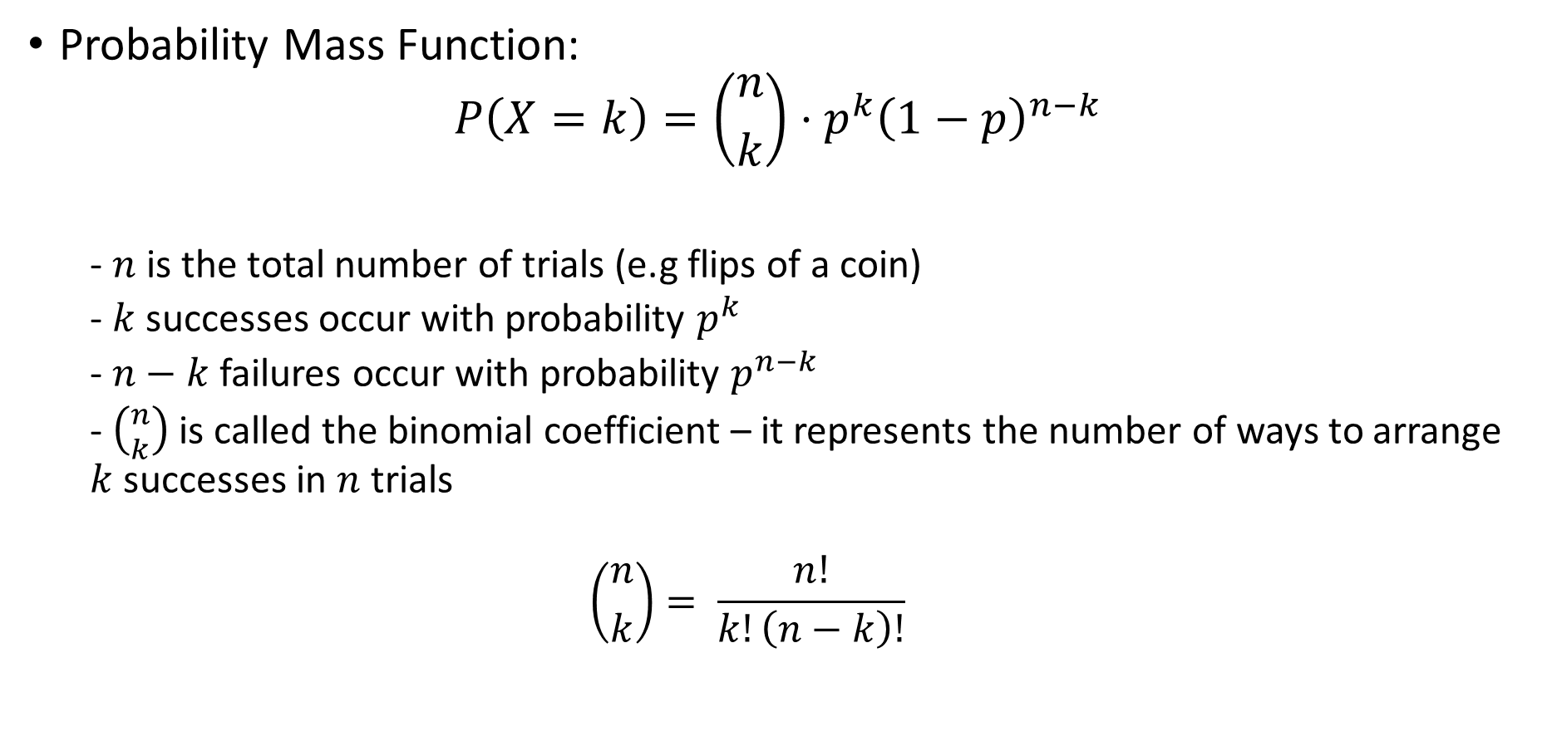
The Binomial Distribution
Probability Mass Function:
$$P\left(X=k\right)=\left({n \atop k}\right)⋅p^{k}{\left(1−p\right)}^{n−k}$$
- $n$ is the total number of trials (e.g flips of a coin)
- $k$ successes occur with probability $p^{k}$
- $n−k$ failures occur with probability $p^{n−k}$
- $\left({n \atop k}\right)$ is called the binomial coefficient – it represents the number of ways to arrange $k$ successes in $n$ trials
$$\left({n \atop k}\right)= \frac{n!}{k!\left(n−k\right)!}$$

Slide 19
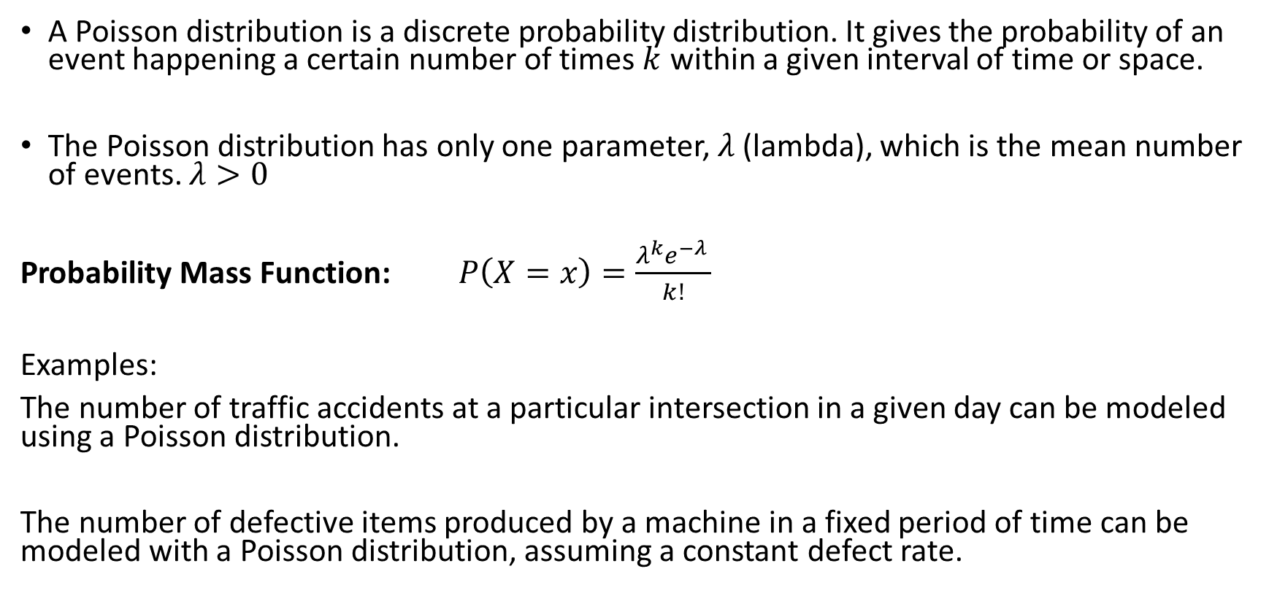
The Poisson Distribution
A Poisson distribution is a discrete probability distribution. It gives the probability of an event happening a certain number of times $k$ within a given interval of time or space.
The Poisson distribution has only one parameter, $λ$ (lambda), which is the mean number of events. $λ>0$
Probability Mass Function: $P\left(X=x\right)=\frac{λ^{k}e^{−λ }}{k!}$
Examples:
The number of traffic accidents at a particular intersection in a given day can be modeled using a Poisson distribution.
The number of defective items produced by a machine in a fixed period of time can be modeled with a Poisson distribution, assuming a constant defect rate.

